Slide 1
KS1 SATs
May
2023
Things we will cover:-
What are SATs in Key Stage 1?
What do the SATs tests look like?
How do teachers use the
information?
What can you do to help?
A parent’s guide to SATs

Slide 2
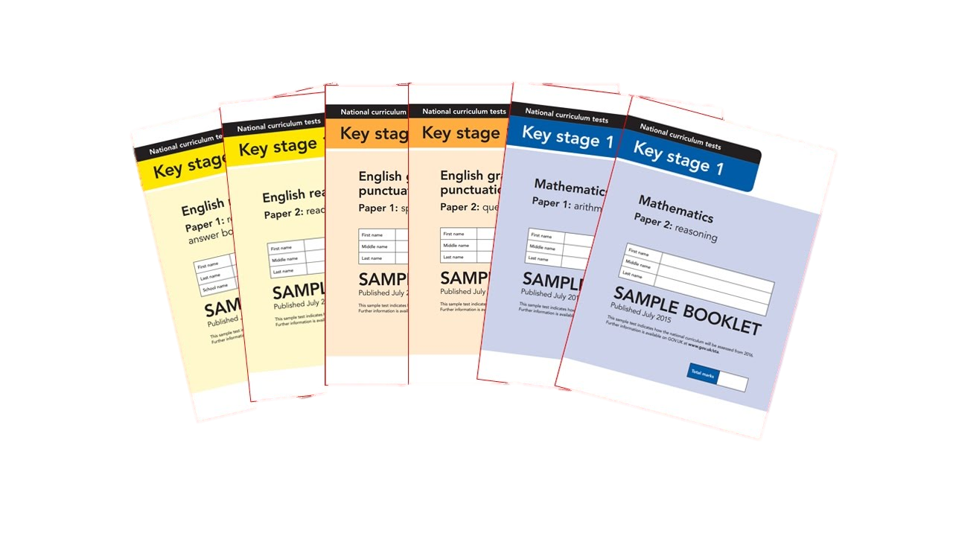
What are SATs?
At Spixworth in Key Stage 1 (Year 2) we refer to these as Secret Agent Tests. This approach is designed to help the children feel at ease. We explain that there is no pass or fail but that these tests are designed to highlight their strengths.
At the end of Year 2 and 6, children in England sit national Statutory Assessment Tests (SATs) in the following subjects, the results are used to measure the school’s performance:-
English – Reading (2 papers)
English – Grammar, Punctuation & Spelling (2 papers)
Maths – Arithmetic & Reasoning (2 papers)
These tests reflect the updated national curriculum and are marked using a scaled score (e.g. 26 marks on the reading paper equals age related 100)

Slide 3
An outline of the tests
Paper 1
Paper 2
Reading booklet with
questions and answer spaces
combined.
Reading booklet with a separate booklet which has the questions and answer spaces.
English Reading
(2 texts totalling 400 – 700 words)
(2 texts totalling 800-1100 words)
Each paper for the KS1 Reading SATs is worth 50% of the available marks.

Slide 4
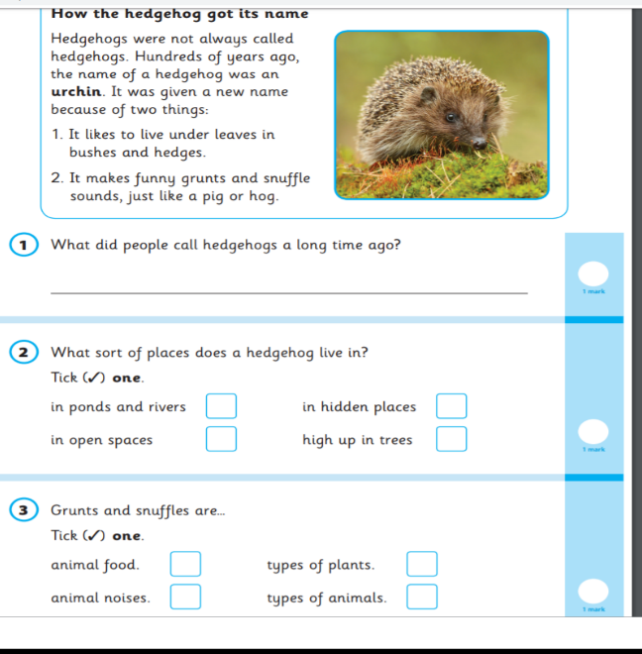
English – Reading Paper 1 sample page

Slide 5
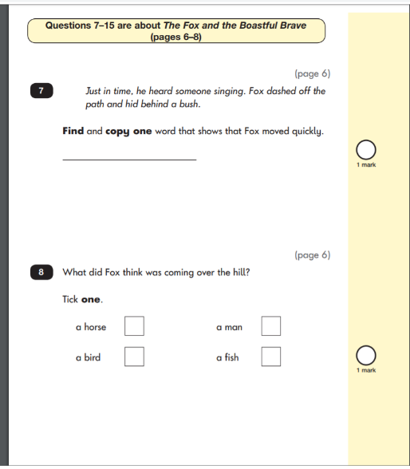
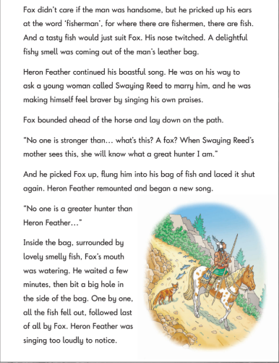
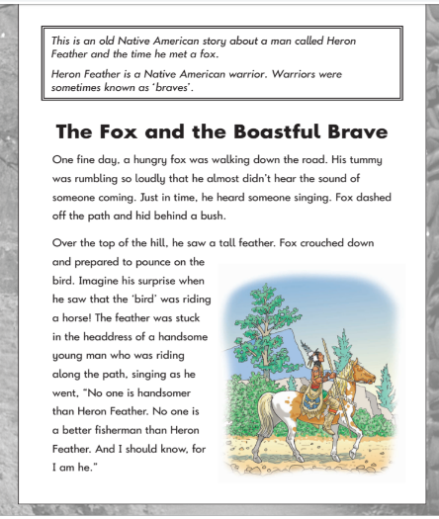
English – Reading Paper 2 sample pages

Slide 6
English Grammar
Grammar, Punctuation & Spelling
Paper 2
Question Paper to check grammar, punctuation and vocabulary
Paper 1
Spelling test of 20 words
Words are based on the graphemes and spelling patterns taught in KS1.

Slide 7
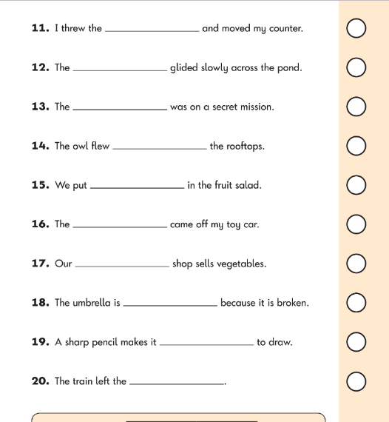
English – Spelling Example Page
English – Grammar Example Page
dice
dice

Slide 8
Maths
Paper 1
Paper 2
Arithmetic
Reasoning, problem solving and mathematical fluency
Arithmetic
& Reasoning
(25 marks available)
(35 marks available)

Slide 9
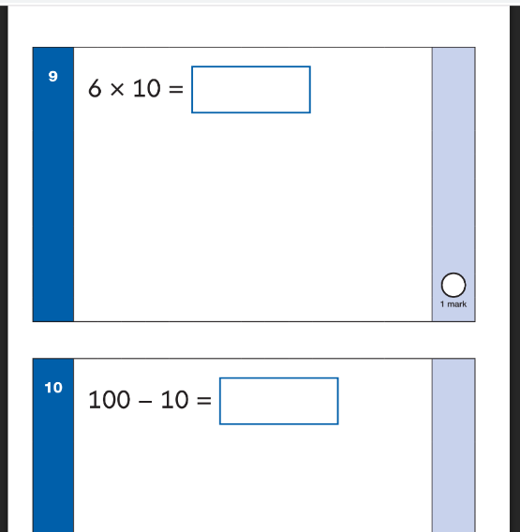
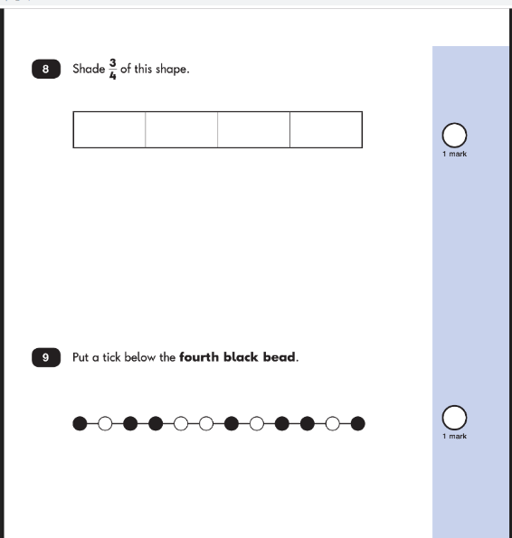
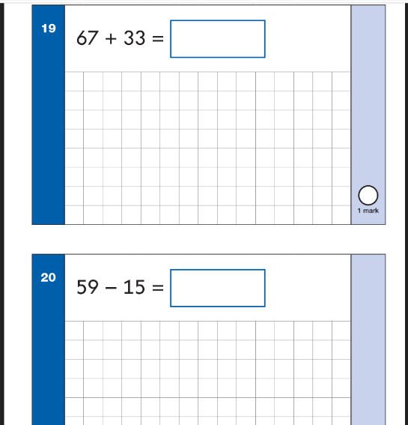
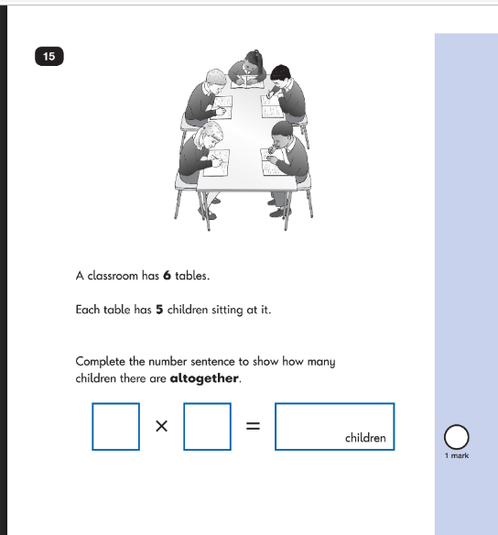
Maths Paper 1 Arithmetic - sample pages
Maths Paper 2 Reasoning - sample pages

Slide 10
Writing
Writing is assessed throughout the year by examining your child’s independent writing. There is no test for this aspect.
The information gained from the Spelling, Grammar and Punctuation papers helps to form our assessments.
Children are assessed based on their coherency of a narrative or non-fiction writing, use of different word types
(e.g. conjunctions, adjectives, noun phrases) as well as their application of the punctuation taught at KS1.
Fiction and non-fiction writing

Slide 11
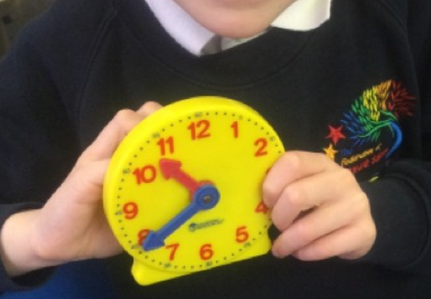
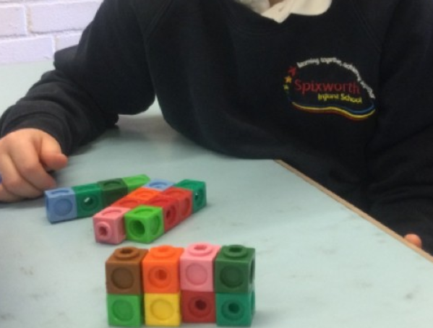
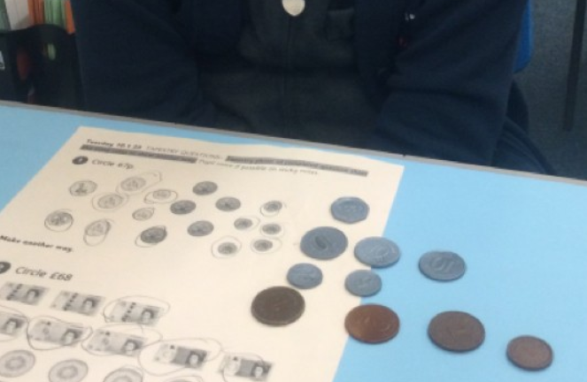
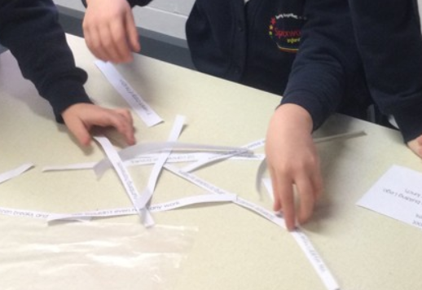
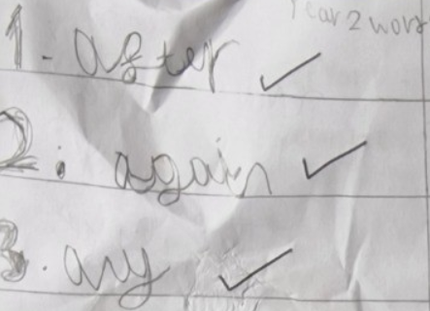
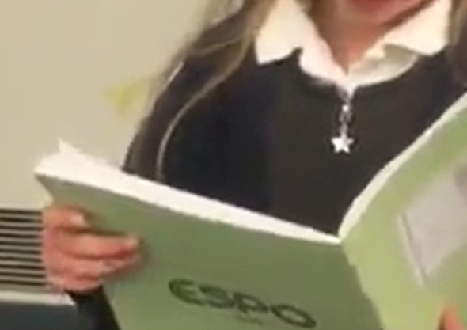
Teacher Assessment/results
KS1 SATs are one part of evidence, teachers use this information alongside work completed throughout the year to make a judgement on what your child has achieved.
They are marked in school, and an overall grading based on the whole year’s work
will be made.
The overall result will be
reported to the Local Authority and to you in your child’s end of year report.
Moderation networks often take place to ensure consistency across schools.
SATs is only PART of the picture of your child’s progress in KS1.

Slide 12
How can you help your child prepare?
Help your child with reading; listen to them read and focus on bringing out a ‘love of reading’. Also reading stories to your child allows them to develop language, listening skills and comprehension. Encourage making predictions about what might happen next. Ask children to recount what has happened, sequence events or consider why a character may act in a certain way.
Help your child with writing; write together with a purpose (e.g. diary writing, letter writing, shopping lists, recounts of trips, etc.), encourage your child to create their own books.
Help your child with maths; play times table games. Encourage them to help with cooking, weighing and measuring ingredients. Work out what time it is together. Provide opportunities for your child to pay for things in cash in a shop, to work out how much things cost and how much change will be needed. Have you tried out White Rose Maths One Minute Maths yet? If you need to be resent the link, please speak to your child’s class teacher.

Slide 13
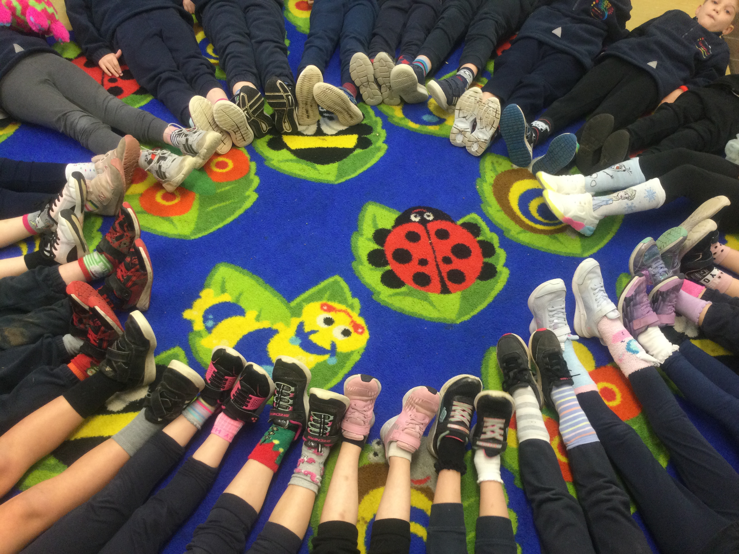
Thank You!
Your time is appreciated.
Any further questions?
Please email these to
office@Spixworth.norfolk.sch.uk

