Slide 1
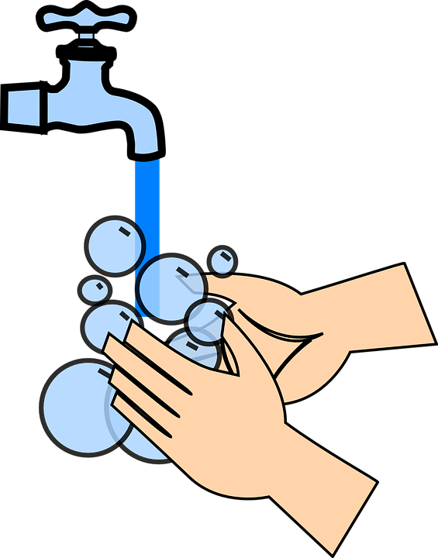
A Social Story About Hand Washing

Slide 2
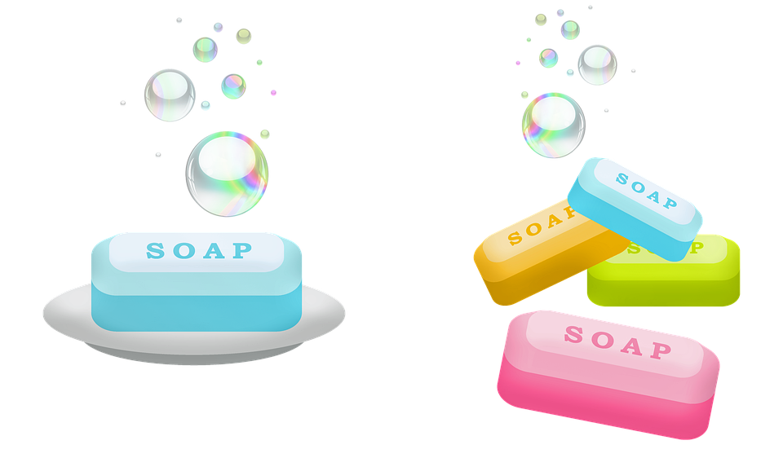
Washing your hands thoroughly is important to keep germs away.
Germs can make us feel poorly.

Slide 3
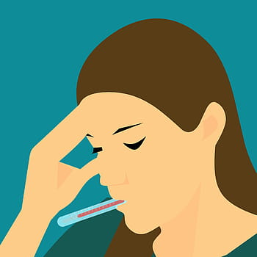
Washing your hands might be boring or feel uncomfortable but it helps to stop us feeling unwell.

Slide 4
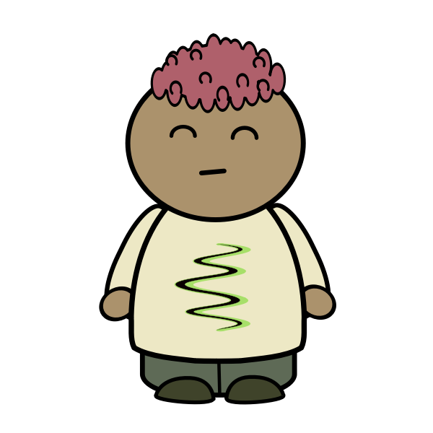
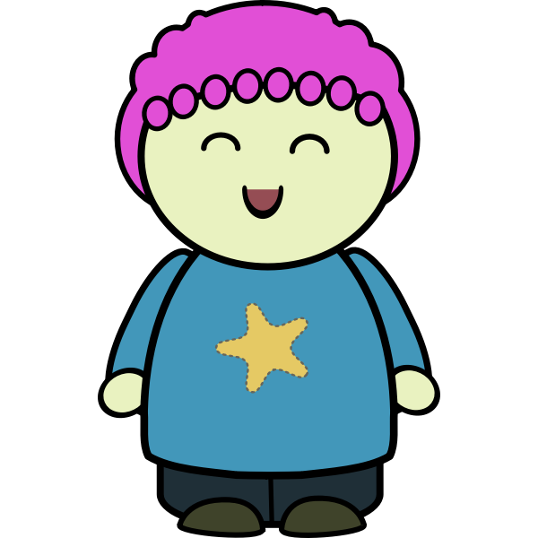
When you wash your hands, you can think about how healthy you are being.

Slide 5
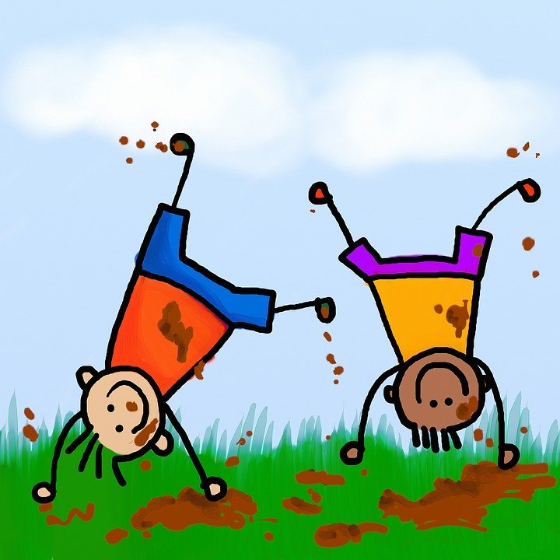
You have to wash your hands when
You’ve been to the You’ve sneezed or coughed Before you eat After getting messy
toilet

Slide 6
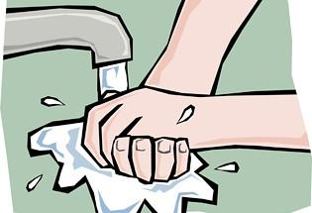
You wash your hands like this:
Wet your hands with clean, running water then turn off the tap
Lather your hands by rubbing them together with soap. Lather the backs and fronts, in between your fingers and under your nails.
Scrub your hands for at least 20 seconds.
Rinse of the bubbles with clean running water.
Dry your hands. .

Slide 7
Note to parents
Please use this social story to help your child with washing their hands.
Social stories are designed to be precise with limited information so please don’t solely rely on this for hand washing advice. The NHS website contains detailed information about how and when to wash hands.
If your child is tactile defensive, please go to our website or contact us directly for further information about handwashing:
www.openarmsupport.co.uk
Thanks, the Open Arms Support Services Occupational Therapists

